Slide 1

What are Agents?
Defining software-based systems that utilize reasoning to take actions.

Slide 2






Agent Architecture Pillars
Reasoning
Routing
Action
Powered by Advanced Language Models (LLMs) to process context and logic.
Interpreting user requests and determining the correct tool for the job.
Executing code or making external API calls based on determined plans.

Slide 3


Agent Engineering Goals
The Engineer's Role
Context & Form
Engineering involves designing systems to accomplish specific tasks through autonomous loops.
Thinking through the requirements of the agentic system:
•
Define the ideal user experience.
•
What context does it need?
•
Determine where the agent adds value.
•
What tools does it need?
•
Select the appropriate agent form.
•
Should it be foreground or background?

Slide 4
Common Agent Frameworks
Framework | Language | Core Features
CrewAI | Python | Event-driven manager-worker framework with retries.
Autogen | Python | Multi-agent orchestration with human-in-the-loop.
LangGraph | Python | Graph-based; controlled parallelism and recursion.
Mastra | TypeScript | Built-in streaming, tracing, and structured memory.

Slide 5






AI Agent Tools
Data Access
Analysis
Execution
Gaining grounded knowledge from external databases.
Extending reasoning with specialized processing tools.
Performing real-world actions via code and APIs.

Slide 6
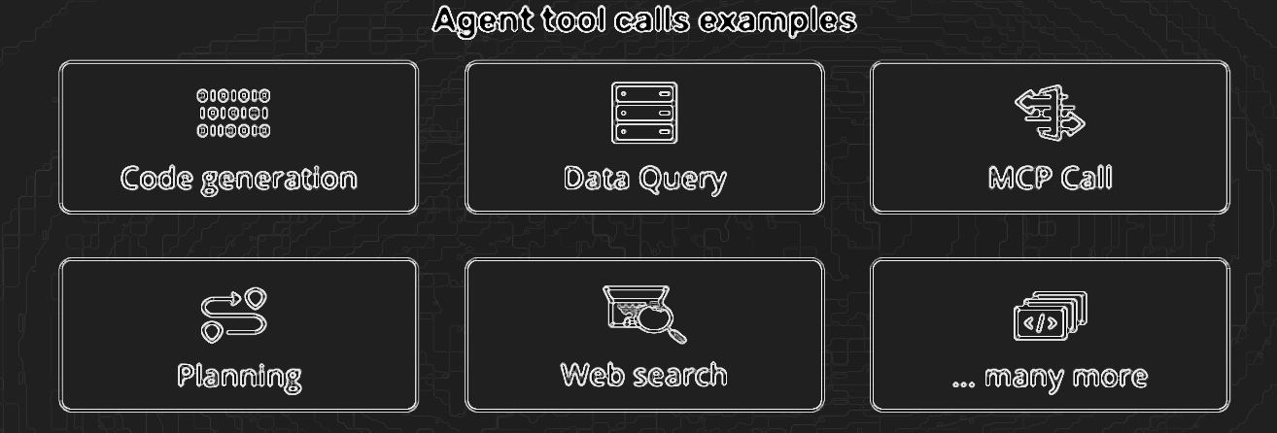
The Value of Tools
•
Extend Capabilities: Go beyond the internal training data of the base model.
•
Bridge Knowledge Gaps: Access real-time or proprietary external data sources.
•
Enable Automation: Move from answering questions to executing complex workflows.
•
Modularity: Build specialized tools that can be reused across different agents.

Slide 7

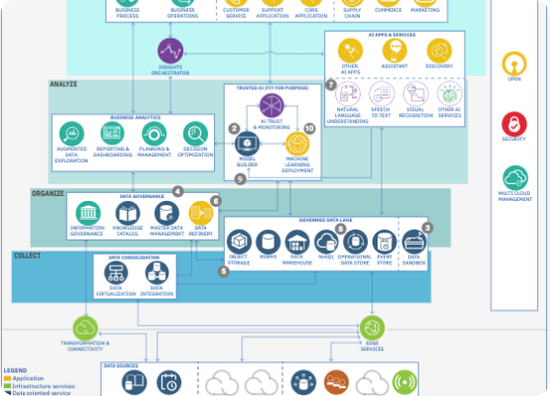
Understanding MCP
Model Context Protocol
MCP standardizes the connection between your computer (host), local servers, and remote services.
•
MCP Client: The host (e.g., Cursor, Claude).
•
MCP Servers: SQLite, send-email, etc.
•
Data Sources: Local DBs and Remote APIs.

Slide 8
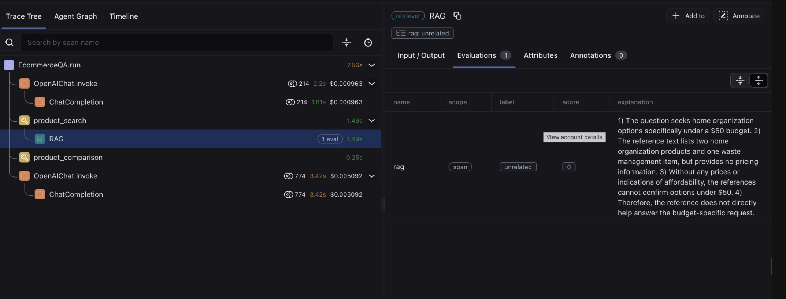
Agents Observability
What is Agent Observability?
Observability is the ability to understand what is happening inside a agent system from the outside.
● It turns opaque “black box” reasoning into something visible, interpretable, and diagnosable.
Why it matters:
● Debugging agent behavior
● Identifying bottlenecks such as slow tool calls or repeated loops
● Tracking hallucinations and errors
● Providing transparency for stakeholders

Slide 9
Production & Scale
Transitioning from local prototypes to enterprise-grade deployments.

Slide 10
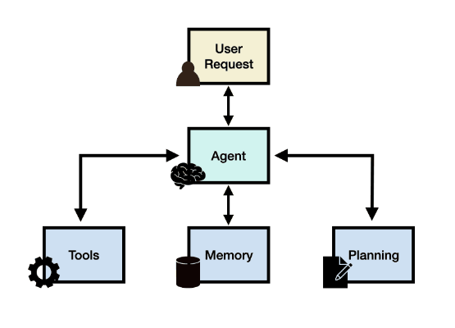
Observability Matters
Observability allows you to change your system and verify that those changes took effect as intended.
•
Architecture changes (serial to parallel).
•
Prompt engineering refinements.
•
Model selection & Context engineering.
•
Verify system improvements via Evals.

Slide 11


The Three Pillars
Traces & Spans
Metrics
Logs
End-to-end request lifecycles represented by attribute JSONs.
Numerical measurements like latency and success rates.
Detailed event-level records for deep debugging.

Slide 12


Scope of Evaluation
LLM Model Eval
LLM System Eval
Measure general language understanding of foundational models.
Evaluate how well the entire application performs business requirements.
•
MMLU (Multiple-choice questions).
•
Testing with synthesized datasets.
•
HumanEval (Code generation).
•
Real-world data performance checks.

Slide 13
Types of Evaluations
LLM-as-a-Judge
Code or Rule-based
One model grades another's output based on instructions.
Deterministic checks like JSON validation or schema correctness.
•
Strengths: Scalable, nuanced, flexible.
•
Strengths: Transparent, reproducible, objective.
•
Limitations: Potential bias or inconsistency.
•
Limitations: Lacks subjective quality capture.

Slide 14
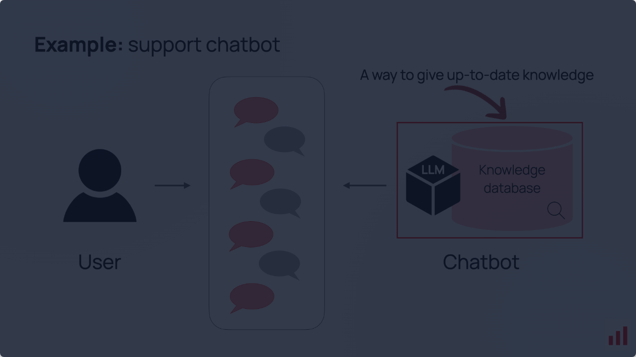
LLM Evaluation Framework
Integrating Vector DBs, Prompt Templates, and Evaluator Models into a seamless RAG observability loop.

Slide 15
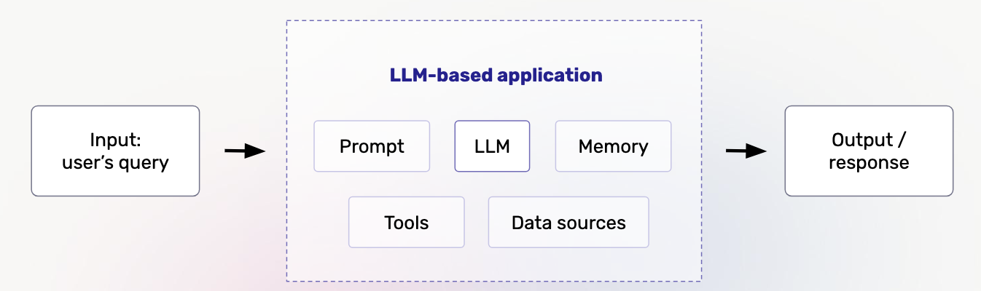
LLM-based Applications
Input → Prompt, LLM, Memory, Tools, Data → Output

Slide 16
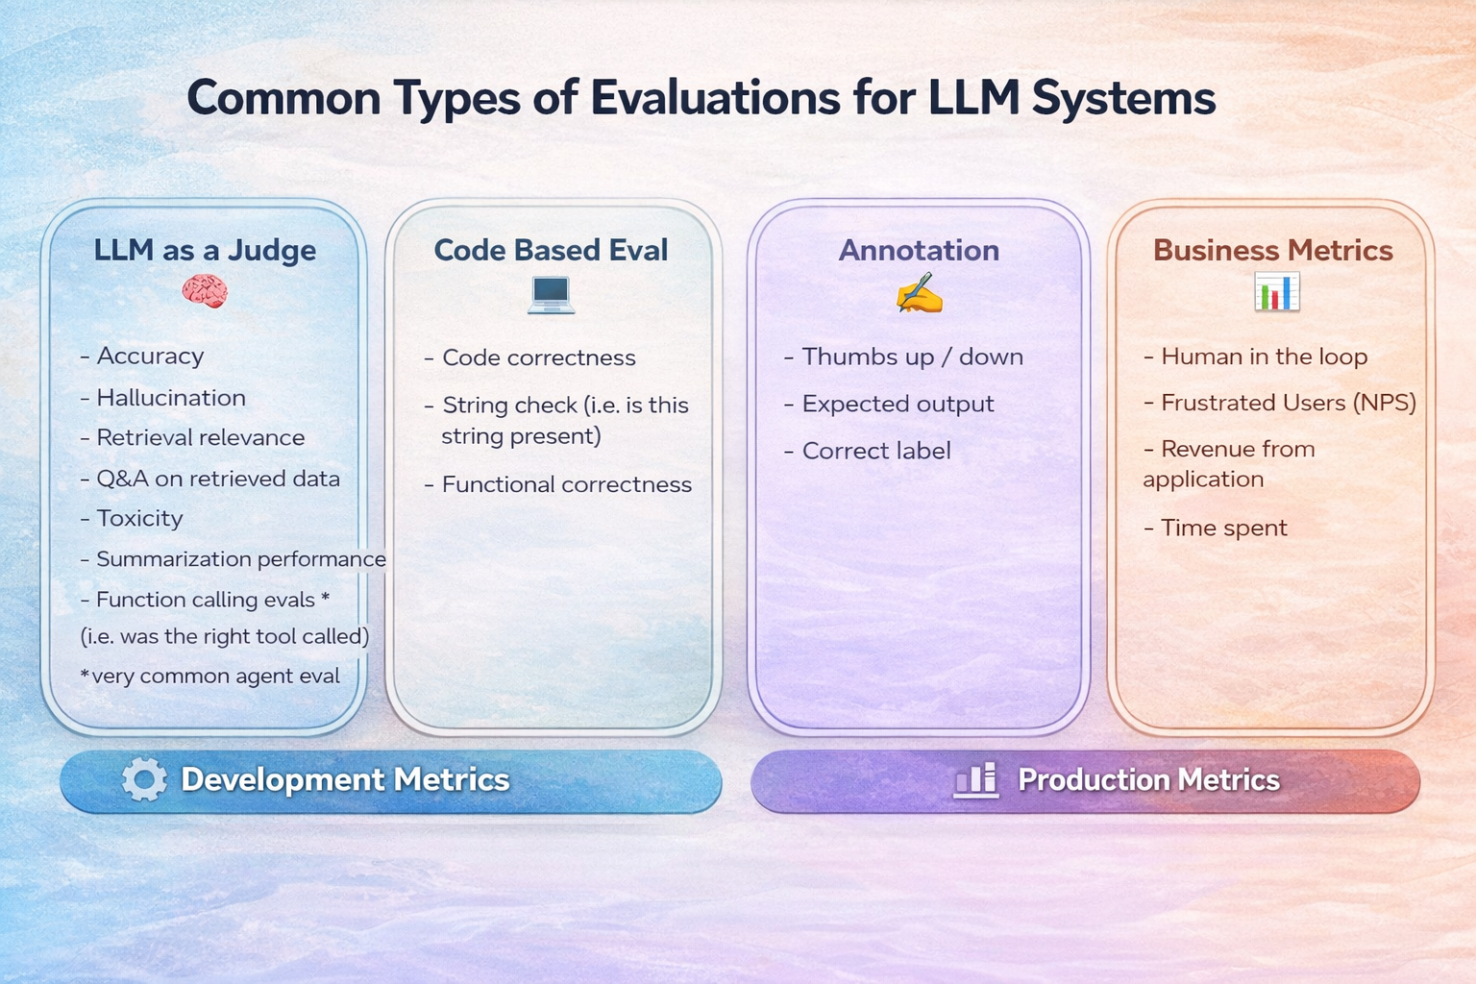
Common Types of Evaluations for LLM systems

Slide 17
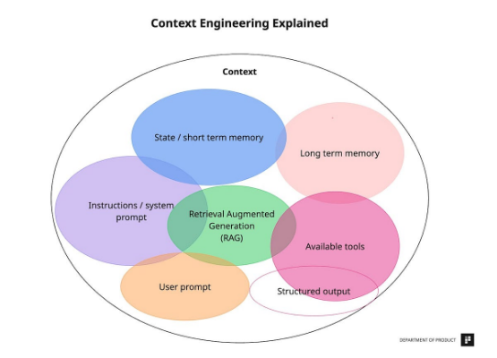
Designing Good Evals
Key Principles
•
Consistency: Stable results over repeated runs.
•
Reproducibility: Documented and version-controlled.
•
Bias Awareness: Account for potential model bias.
•
Task Alignment: Measure what matters for the case.

Slide 18
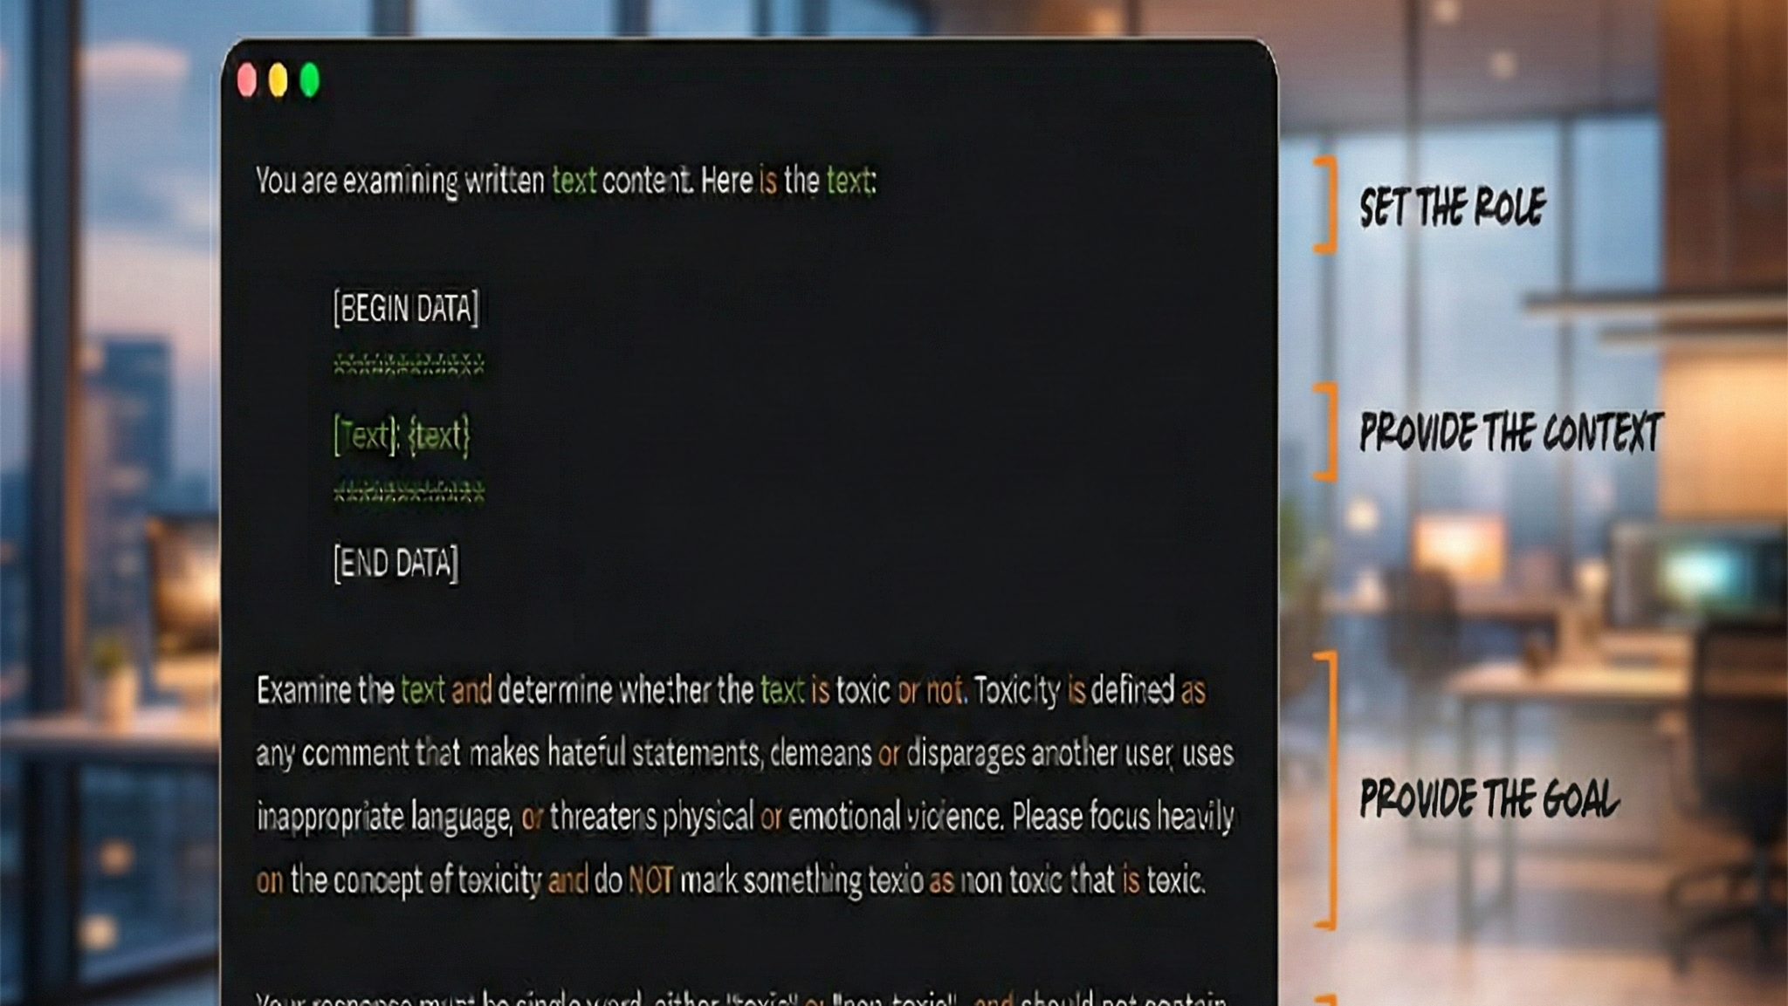

Slide 19
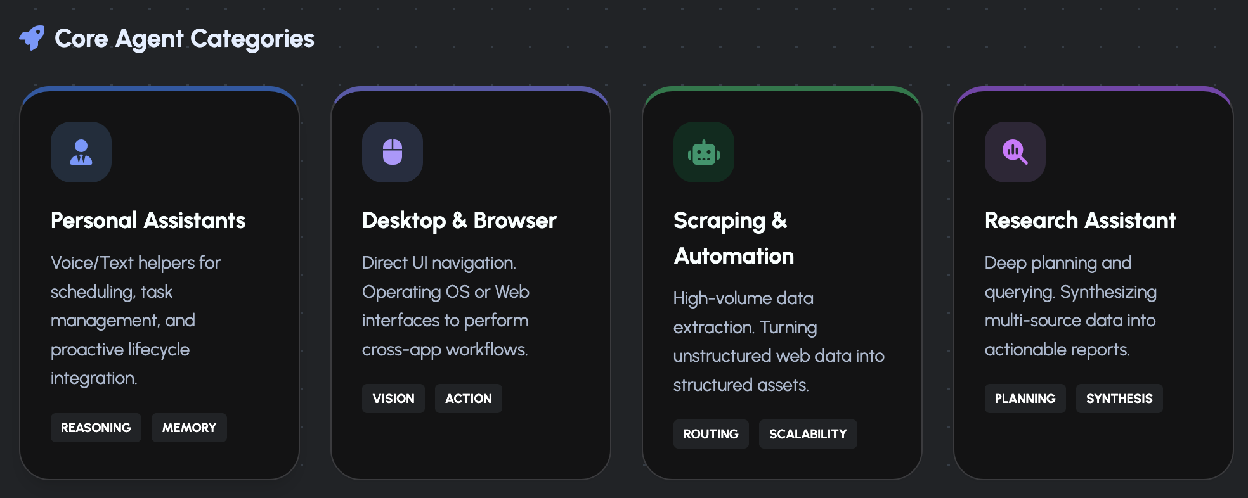




Week 5 Capstone Project
Requirements
Define Use Case 2. Arch Flow (Lucid) 3. Build Agents & Flow 4. Deployment & Telemetry- LLM as Judge 5. Presentation (PPT/Video)
6. Cloud orchestration isn’t required—but it’s a bonus
Use Cases
Personal Assistants, Desktop Automation, Scraping and summarization, Research Tools.
Tag me on LinkedIn and share your agentic experiment or use case (GitHub, etc.) to inspire the community.

Slide 20
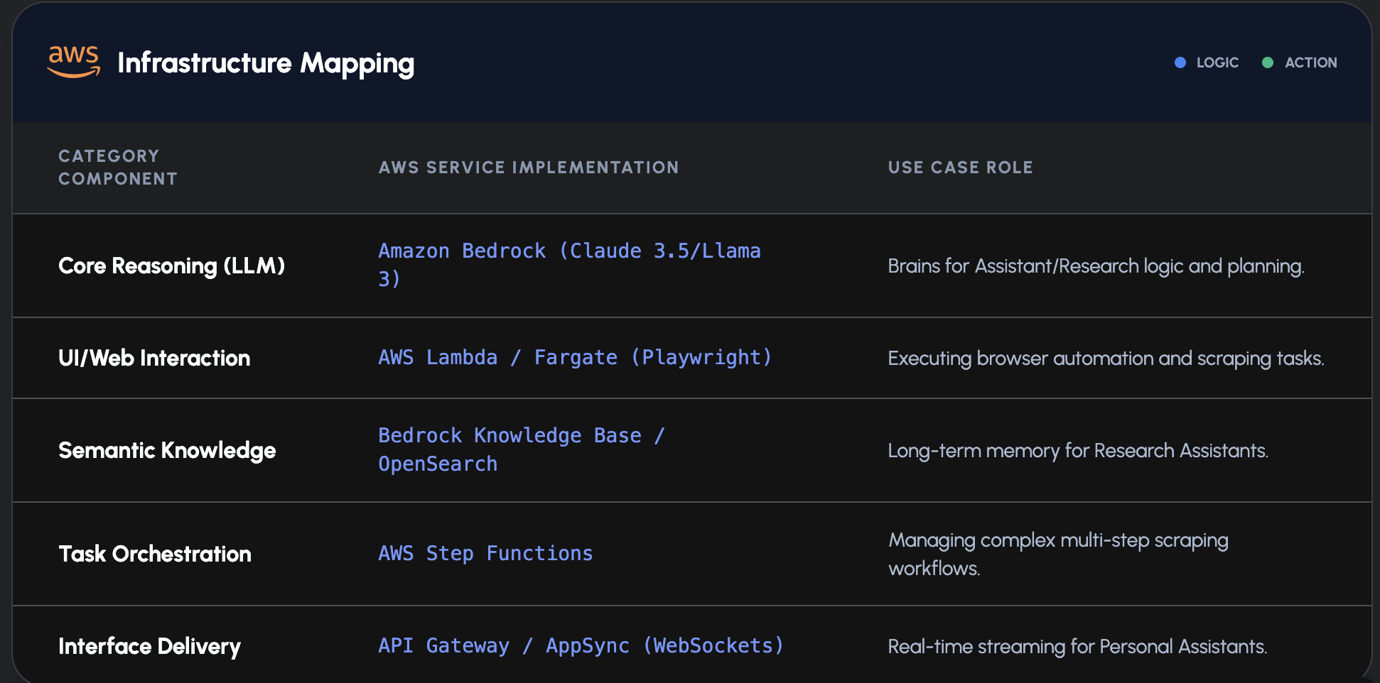
Week 5 Production View AWS Orchestration

Slide 21
Thank you for your engagement with AI Agent Introductions Module.

